Slide 1
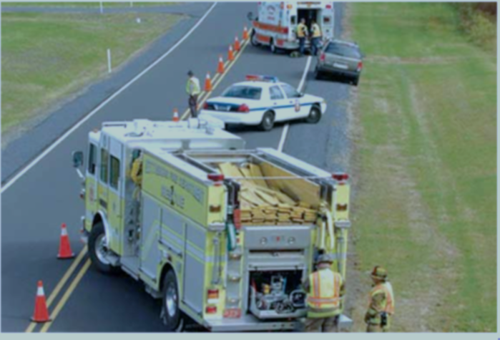
Project Presentation Incident Detection Using Multiple Data Sources
Pranamesh Chakraborty
Shefang Wang Bijan Vafaei
Feb 9, 2017
Notes:
Our project will be mainly concentrate on Incident Detection by using multiple data sources

Slide 2
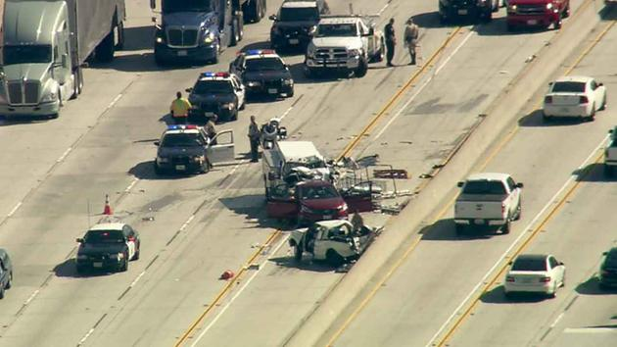
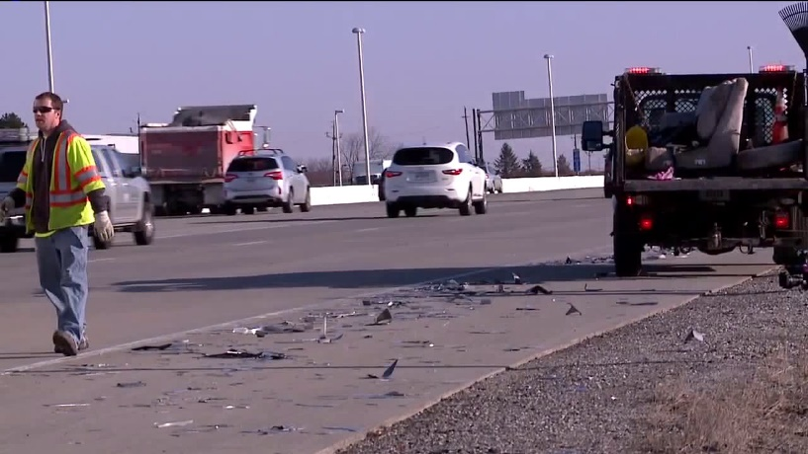
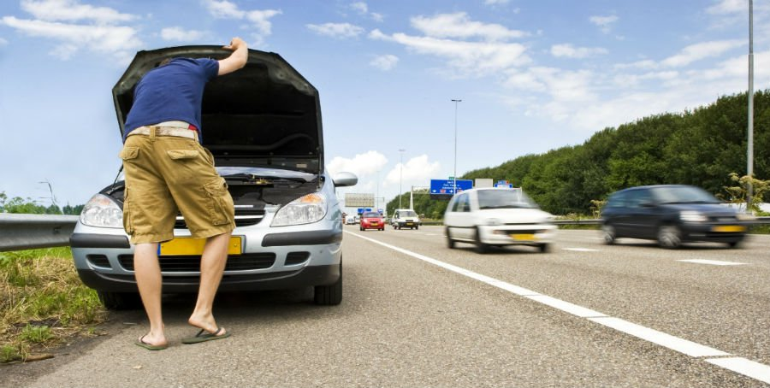
INTRODUCTION
What is Incident?
Crashes
Debris
Shoulder Closure
Lane Closure
Traffic Jam / Slow Traffic
Adverse Weather
Work Zone Activities
Notes:
For those of you who might not know what is the definition of incident. Any sort of crashes, debris on road and shoulder and any type of lane or shoulder closure consider as an incident.
Some sources consider Traffic Jam, adverse weather condition, slow traffic and work zone also as an incident. In our case we will not consider them as we already know and have information about those type and there is nothing that we can do regarding them in terms of detection them and sending the group down to the roads

Slide 3
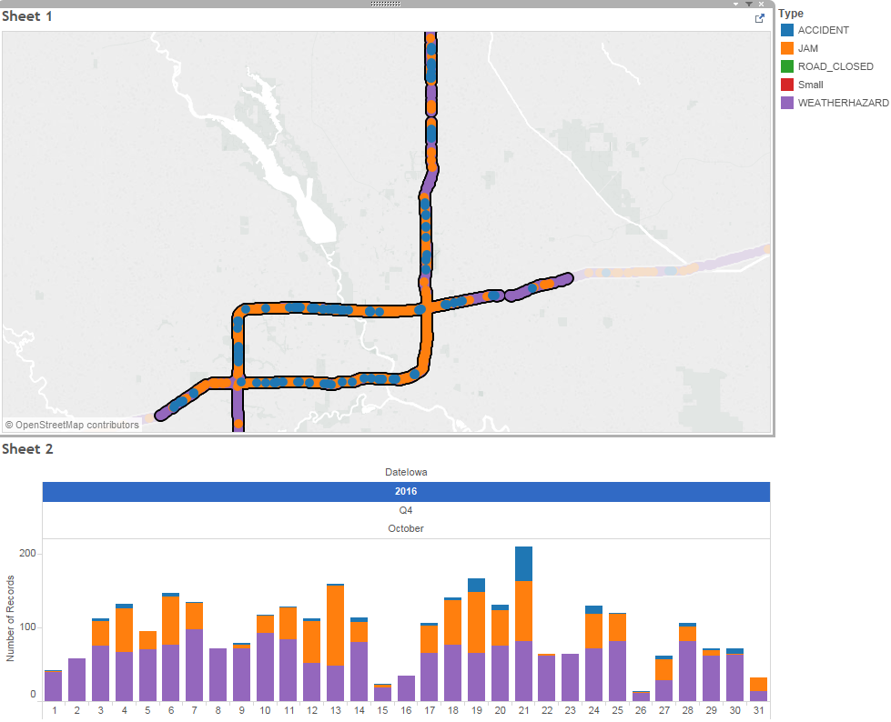
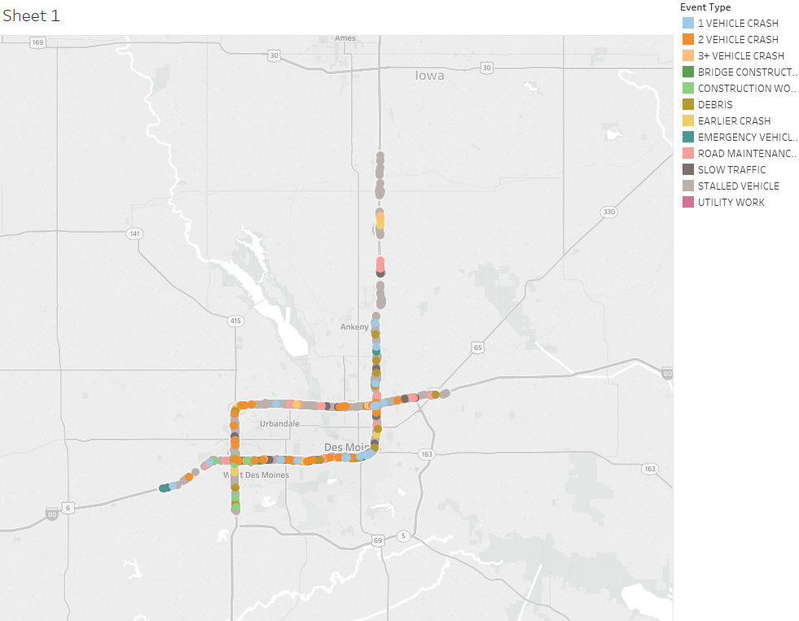
RESEARCH OBJECTIVE
WAZE
Actual Incident Report Iowa DOT
Notes:
The research objective is to implement the detection algorithm for each individual data source we have in hand including waze, Inrix and Wavetronix and QA/Qc it with video log and calculate the detection rate and false alarms and also develop an algorithm to use all data sources we have and compare the detection rate and false alarm. We hope to reach an incensement in detection rate and deduction in false alarm.

Slide 4

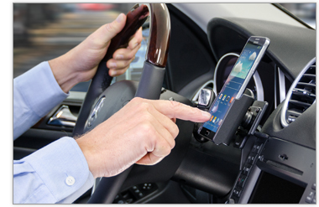
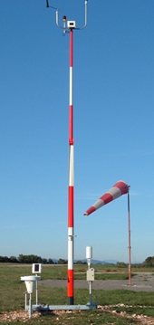
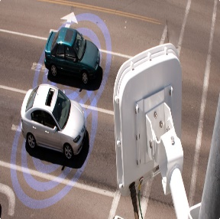


DATA
INRIX
WEATHER
WAVETRONIX
WAZE
160 GB / Month
110 GB / Month
7 GB / Month

